Slide 1
The Lingua Franca Core and American IEP Instructors
YZ
Ann Janosik
English Programs for Internationals
July 3, 2013

Slide 2
What is English as a Lingua Franca?
YZ
How does this development impact us?
YZ
What aspects are useful to us as IEP teachers in the USA?

Slide 3
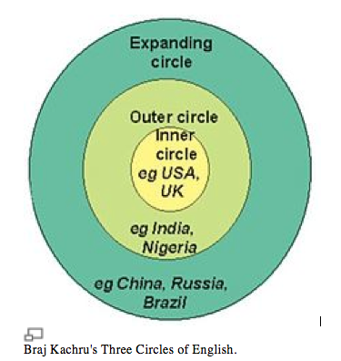
Background
Notes:
Inner circle: UK, USA, Australia, Canada. 2003 est is 400 million. English is the speakers first language.
Outer Circle: ESL. E is spoken as a second language. Generally spread as a result of migration of NS from British Isles. Former colonies. E now has special status for administration, education, media. E no longer regarded as a foreign language, and local varities may arise: Indian E, Nigerian E, Singapore E. Est 430 mill
Expanding circle: Successful E sp for whom E is not a 1st L, second L, or official L. Not native-like. Medium level of conversational competence.

Slide 4
Implications
Speakers from Expanding Circle countries are changing English and its pronunciation
New Non-native speaker pronunciation developments do not correspond to standard native speaker norms
Gaining competence in order to communicate with native speakers can no longer be assumed to be the goal.

Slide 5

The Creation of the Lingua Franca Core
Jennifer Jenkins, Chair of Global Englishes and Director of the Centre for Global Englishes at the University of Southampton, England
Notes:
Communicative Language Teaching placed a heavy emphasis on suprasegmentals at the cost of work on the individual sounds, but JJ research found otherwise. In her study, all breakdowns from pronunciation were caused by the transfer of L1 sounds.

Slide 6
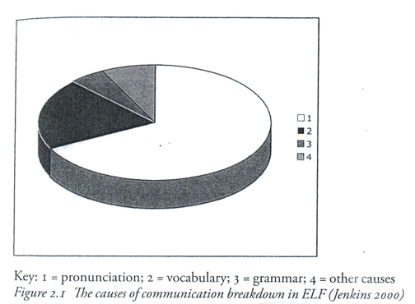
The causes of communication breakdown in ELF

Slide 7
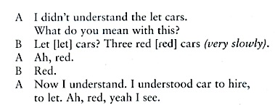
Acoustic Processing Errors

Slide 8
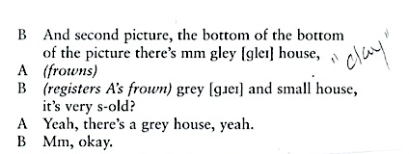
Notes:
WHY? JJ suggests that NS and higly proficient NNS use top-down processing to access meaning and reinterpret what they think they have heard when perceived meaning does not make sense. NS of lower levels of profic employ bottom-up processing. They are heavily dependent on the acoustic signal—the actula sounds they hear. They are so dependent that they are completely thrown by deviations in the individual sounds, even when there are clear linguistic or extra-lingustic clues that contradict the sense of what they think they heard. WALKER

Slide 9
Pronunciation Issues
Goal: mutual intelligibility for NNS
Accentedness ≠ intelligibility
Preservation of identity
Teachability
Bottom-up processing

Slide 10
LFC Intelligibility: Four Requirements
Individual consonant sounds
Consonant clusters (deletion vs insertion)
Vowels (quality vs quantity)
Nuclear stress placement
Notes:
Need to note examples here
(no th or dark l; rhotic r)

Slide 11
Nuclear Stress Placement
Gilbert: Prominence and thought groups
Celce-Murcia: Intonation Units
Ex: pairwork exercises in perceiving and placing nuclear stress
Ex: Practice in placing contrastive stress

Slide 12
Non-core features:
Features that do not impact ELF intelligibility
Features that have a negative impact on ELF intelligibility

Slide 13
No impact:
Pitch movement (tone, melody, intonation)
Word stress (grey area)
Stress-timing (sentence stress)

Slide 14
Negative Impact
Vowel reduction, schwas, weak forms
Features of connected speech (reductions and linking)

Slide 15
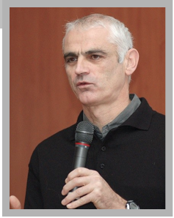

Robin Walker: Teaching the Pronuncation of English as a Lingua Franca

Slide 16
Walker’s list of advantages
Increased progress and achievability when unteachable items such as intonation are dropped
No longer sees L1 accent as a fault
Mother tongue as a benefit
No conflict between accent and identity
Applies useful transfers
Allows more use of NNS teachers

Slide 17
Implications for IEP Instructors
Training NNS teachers: a possible issue
Better understanding of student needs and goals
Professional knowledge
Instructional priorities
Food for thought

Slide 18
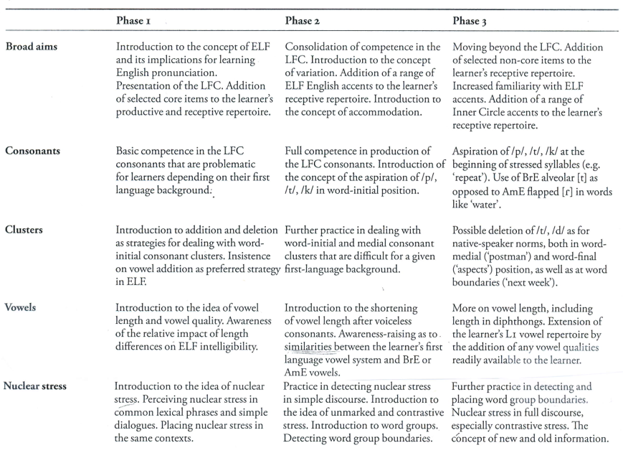
Suggested Syllabus

Slide 19
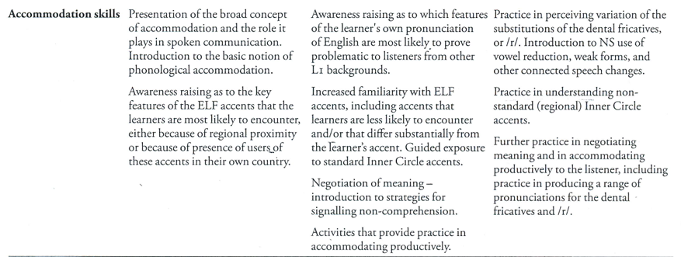
Syllabus--Accommodation

Slide 20
Useful ideas:
Pronunciation priorities
Suggested pronunciation syllabus
Suggestions for the monolingual classroom
Importance of bottom-up processing
Importance of accomodation
Notes:
Why spend long periods of time in the TH when teaching a German speaker who will be working with Russians?

Slide 21
Accommodation
Standard exercises for feedback: information gap exercises
Suggestions for the monolingual classroom: Student recordings

Slide 22
Student recordings for the monolingual classroom
Focus on and pre-teach a small number of selected pronunciation points
Practice these features in class with drills, minimal pair activities, etc.
Students prepare at home and in small groups. Small groups listen to members and offer feedback
Students record as often as wished until are satisfied.
Groups listen to recordings and critique.

Slide 23
Activities for Nuclear Stress
Pairwork exercises in perceiving and placing nuclear stress
Practice in placing contrastive stress

Slide 24
Sources
Jenkins, Jennifer. 2000. The Phonology of English as a Lingua Franca. Oxford: Oxford University Press.
Walker, Robin. 2010. Teaching the Pronunciation of English as a Lingua Franca. Oxford: Oxford University Press.

